Slide 1




WELCOME
42nd Annual Mines Safety Week Celebration-2024
(Under the Aegis of DGMS-Bhubaneswar Regions 1&2)
Kick-Off Meeting
Date-8th November 2024
Venue- EZMA Hall, Barbil
Many Roles, One Goal - Building Safety Together

Slide 2
AGENDA
Sl. no | Description | Time
1 | Welcome to Guests & Lighting of Lamp
2 | 1 Minute Silence in the memory of all Miners those Sacrificed their lives during service.
3 | Address by DMS Region-1 & Chairman of 42nd AMSWCC-2024
4 | Sharing of Events (Defensive driving & Trade tests).
5 | Status of Participation & Advertisement fees
6 | Status of nomination for accident-free workers, PSC member, best women employee & transgender.
7 | Status of souvenir articles from Mines.
8 | Status of nomination for first aid & quiz competition.
9 | Status on Lifetime Achievement Nominations
10 | Discussion on Mines Inspection, GVTC & OHC Inspection Schedule & feedback
11 | Discussion on Marksheet for Mine Inspection, GVTC & OHC Inspection.
12 | Mode of sharing inspection results.
13 | Accommodation of Inspecting Team Members
14 | Suggestions & feedback.
15 | Vote of Thanks
16 | Distribution of Prizes, Badges & Flags.

Slide 3
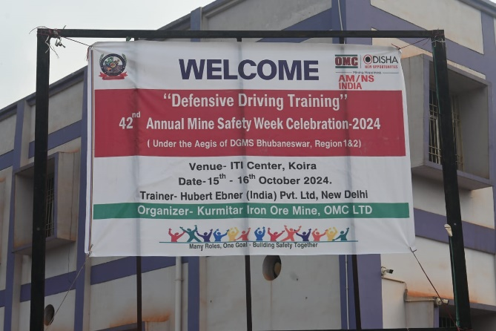
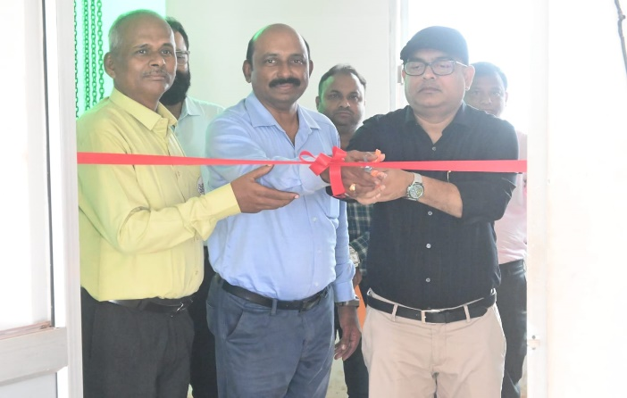
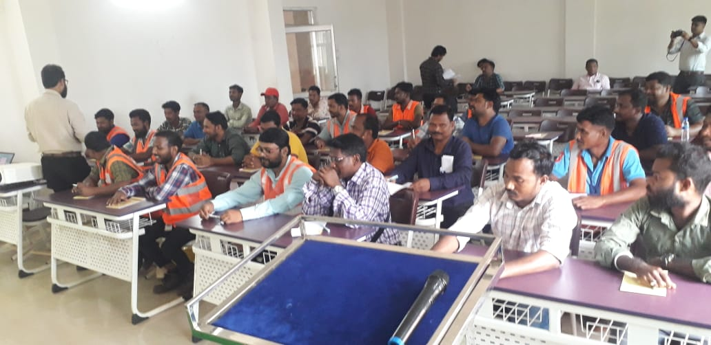
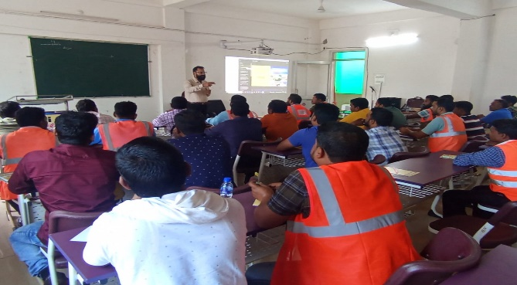
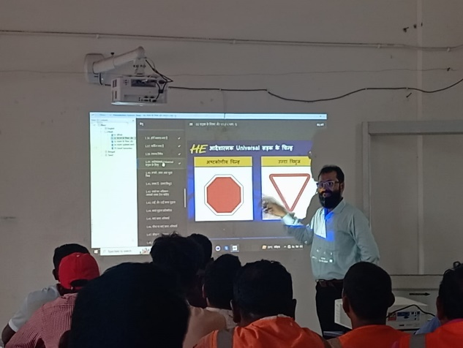
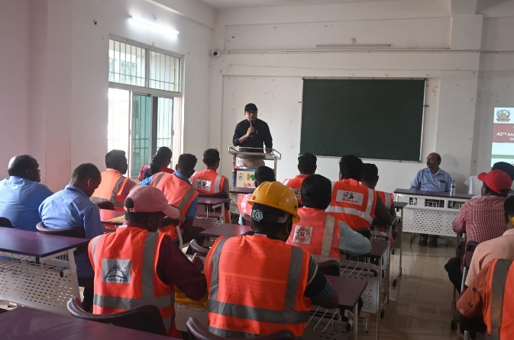
Defensive Driving
VENUE:- Koida-ITI

Slide 4
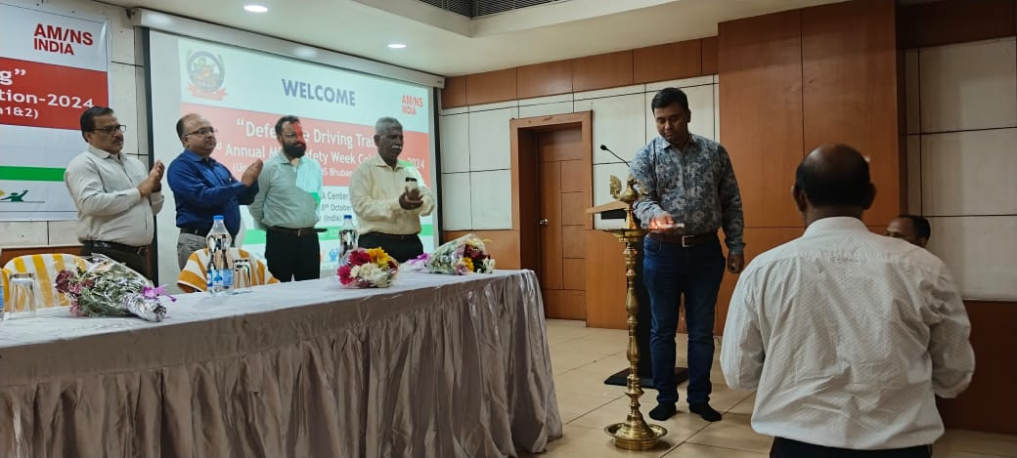
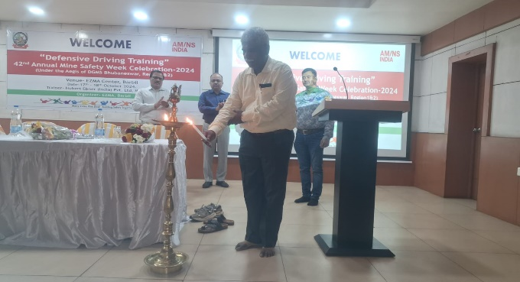
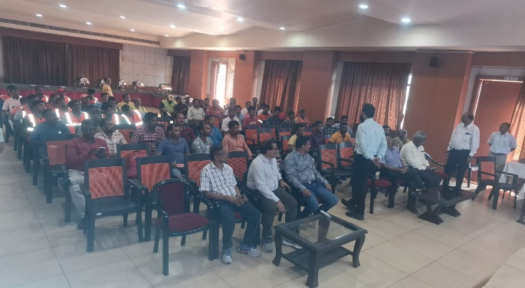
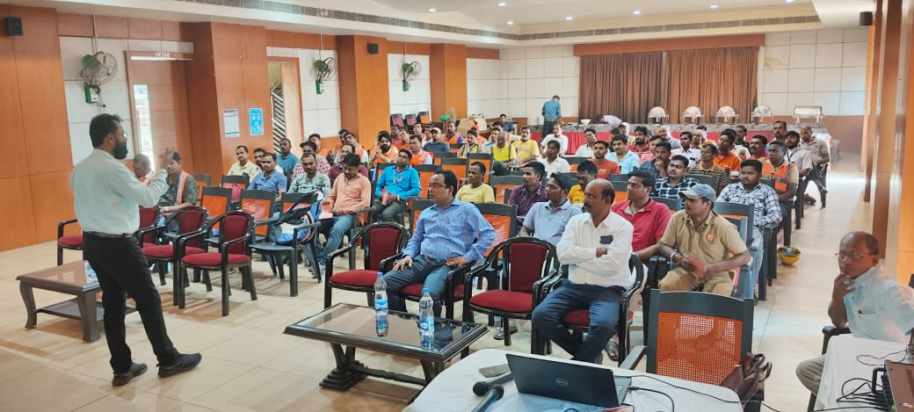
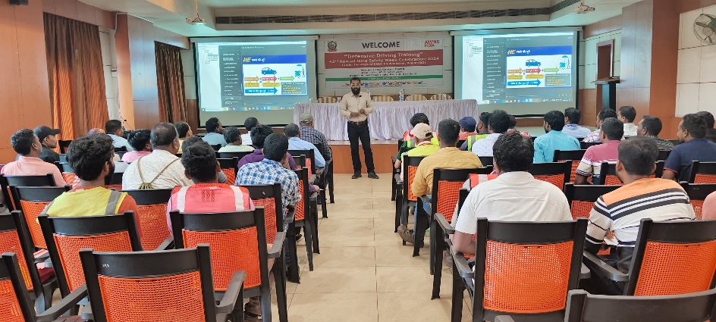
Defensive Driving
VENUE:- EZMA, Barbil

Slide 5
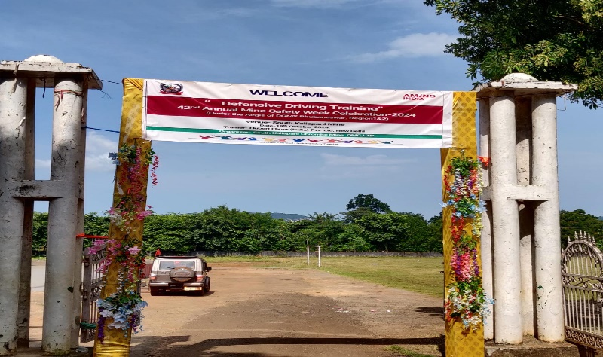
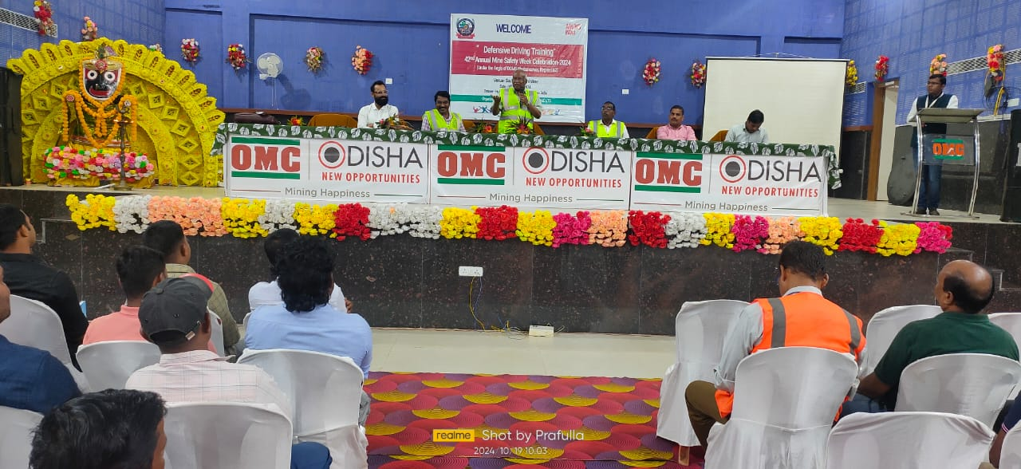
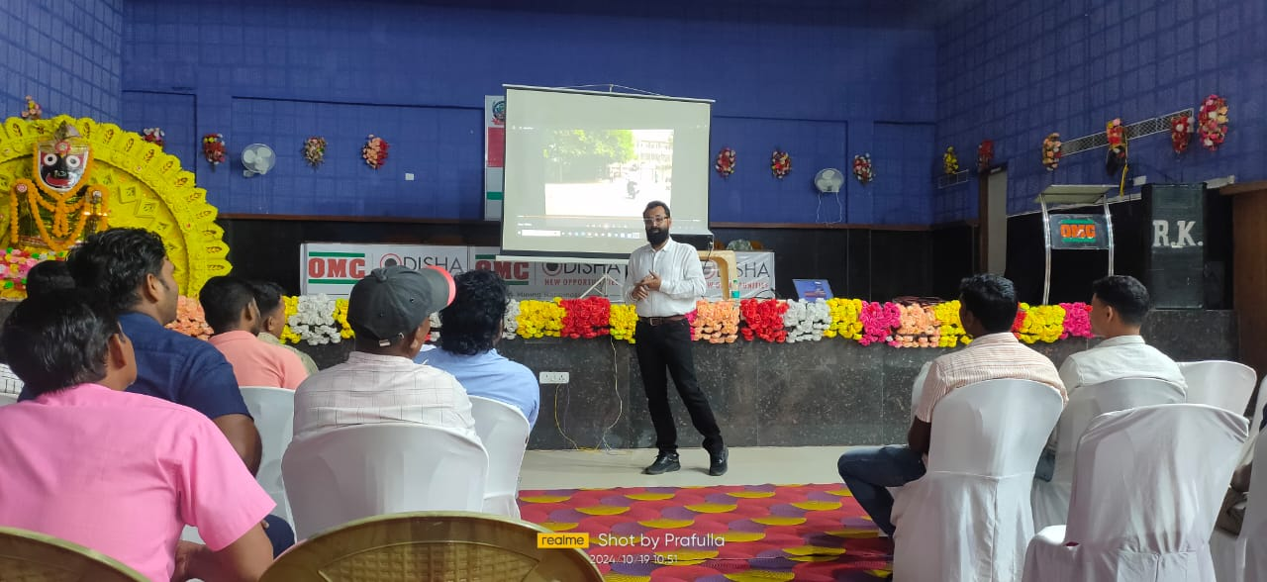
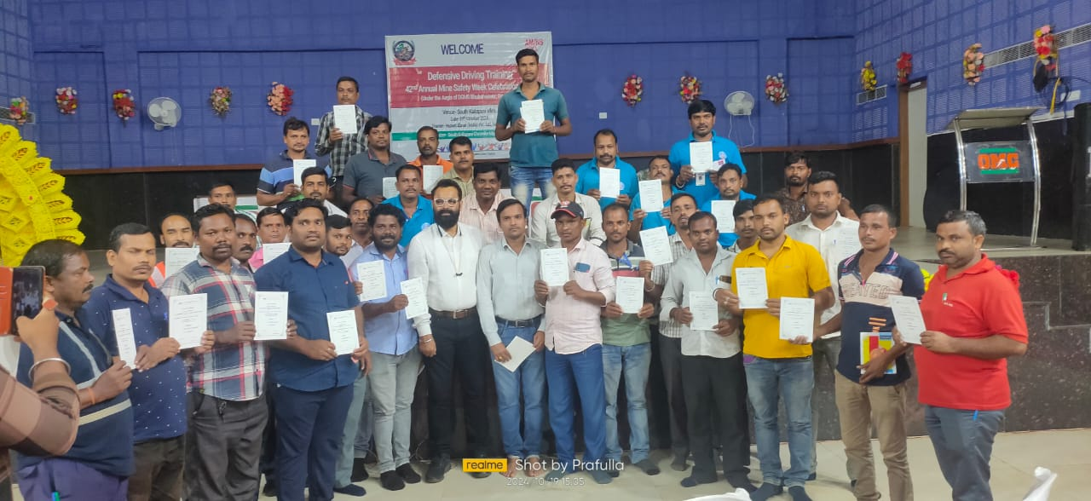
Defensive Driving
VENUE:- South Kaliapani Mine

Slide 6
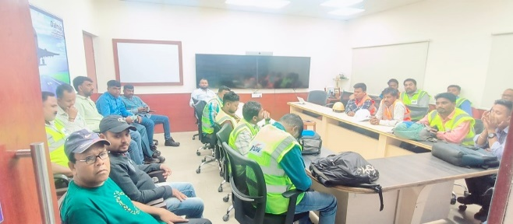
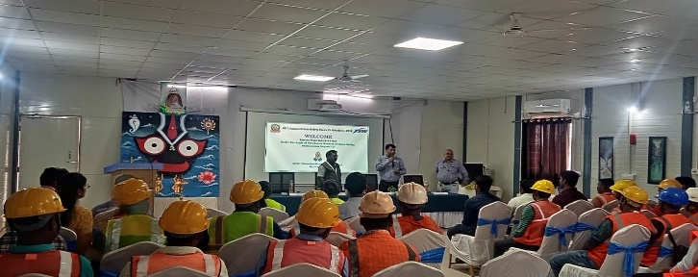
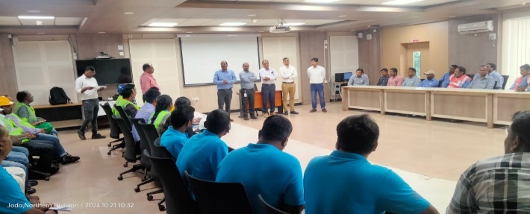
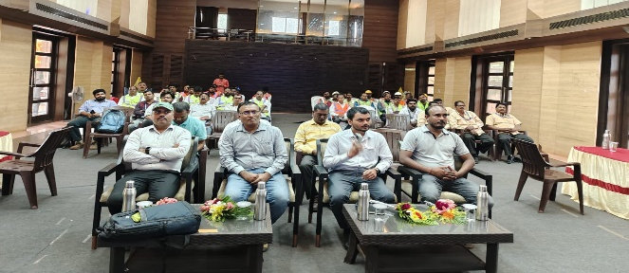
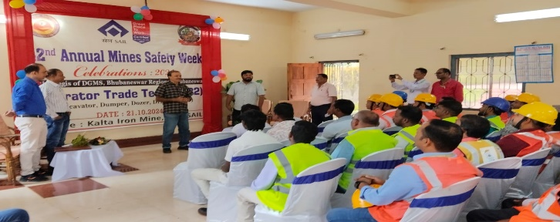
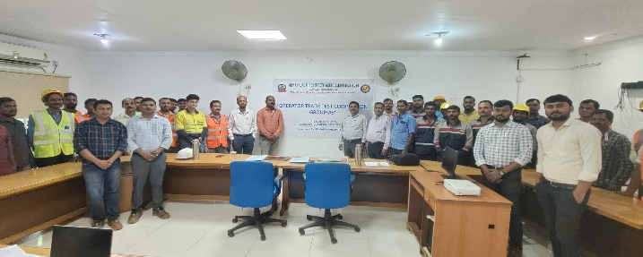
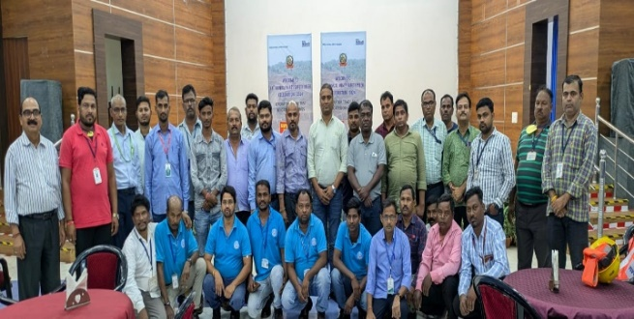
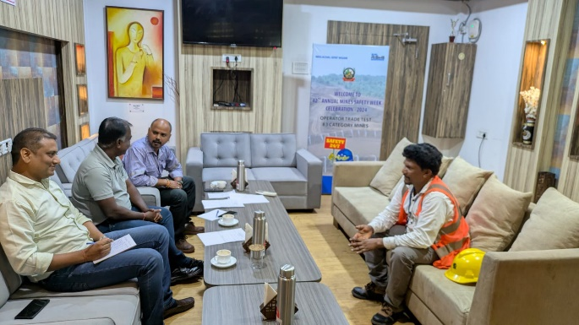
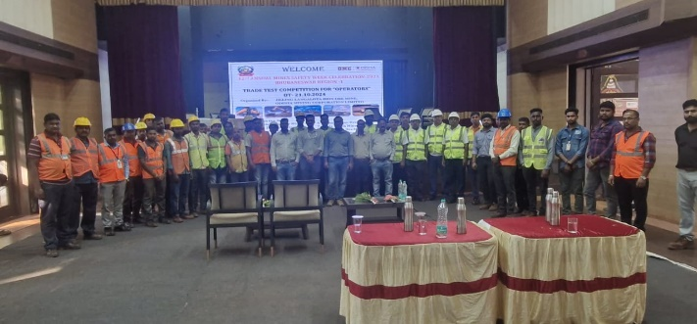
Trade Test
Trade:- Operators

Slide 7
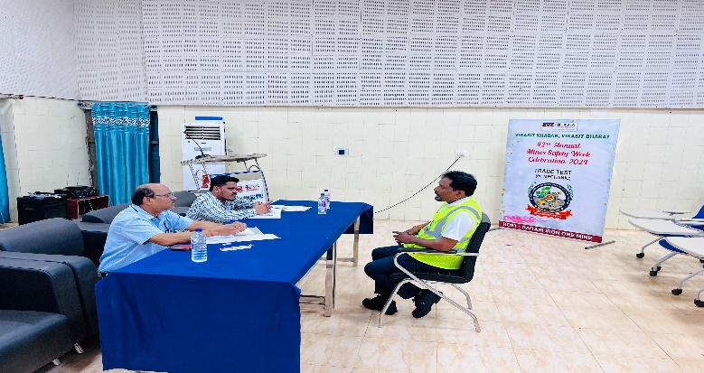
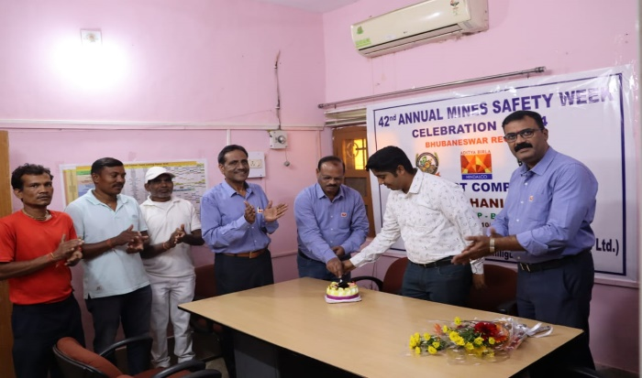
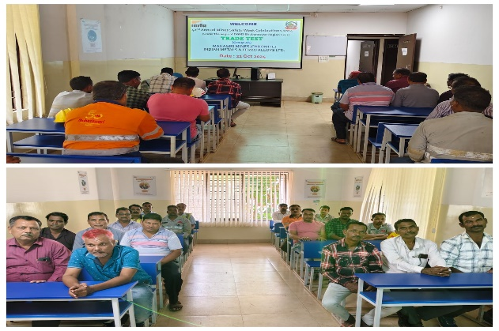
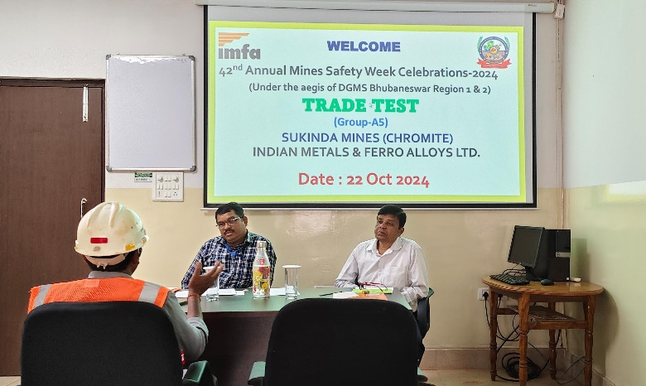
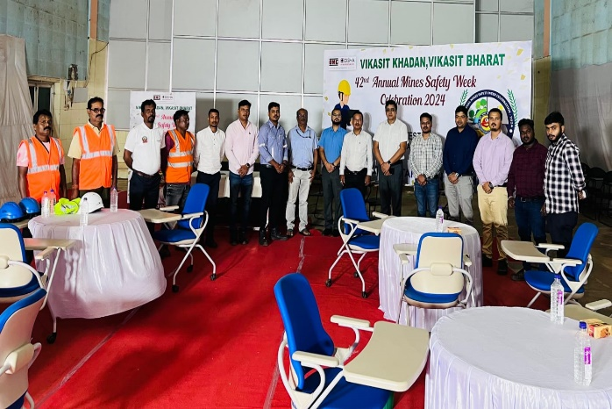
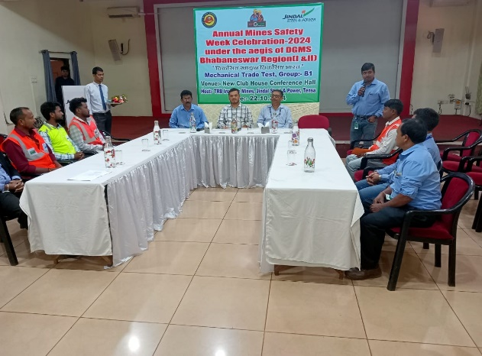
Trade Test
Trade:- Mechanic

Slide 8
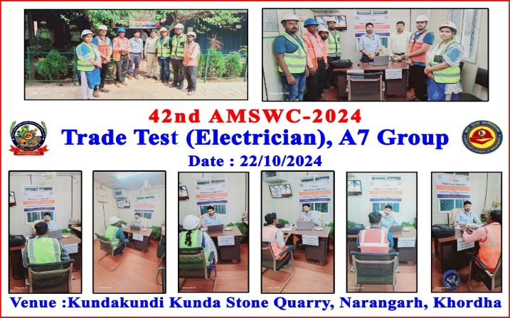
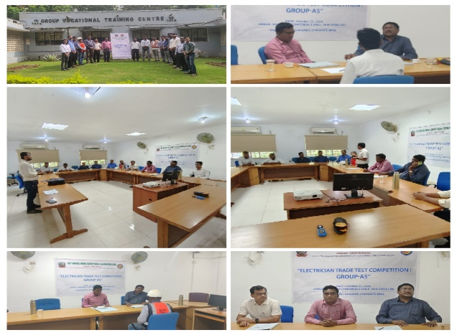
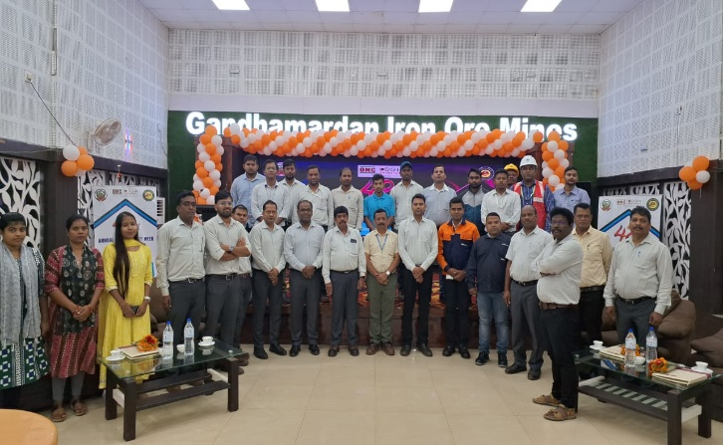
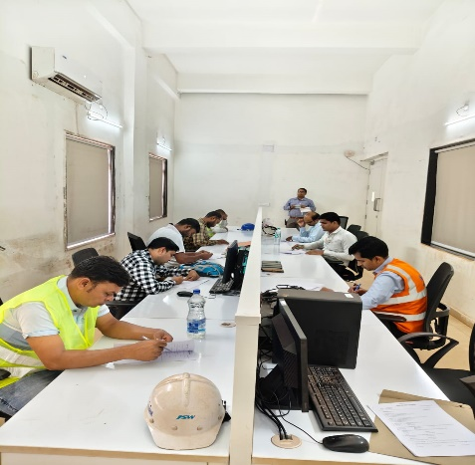
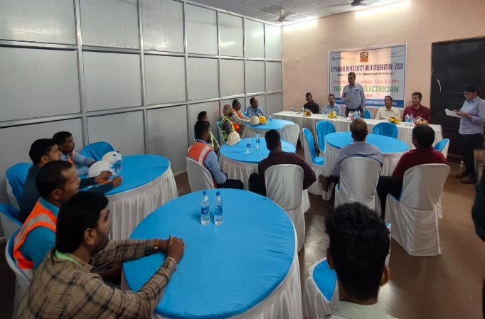
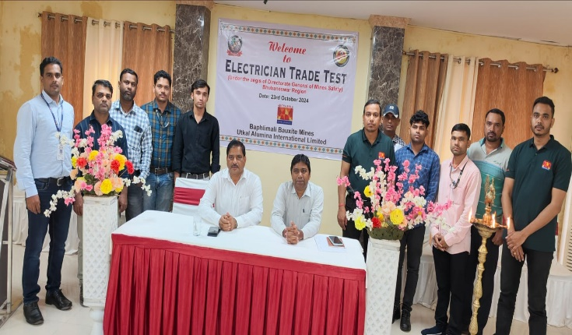
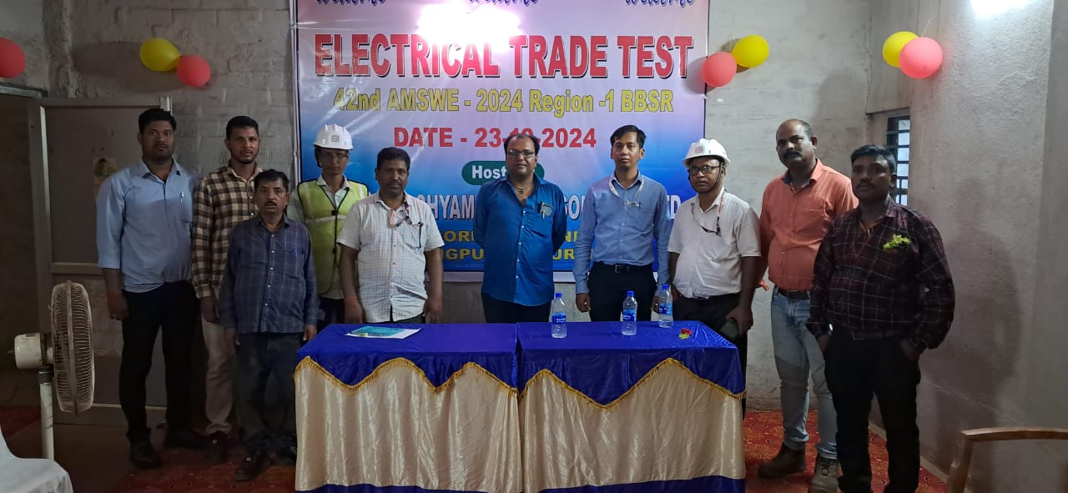
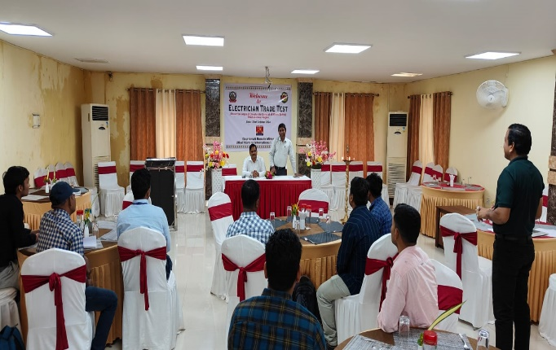
Trade Test
Trade:- Electrician

Slide 9
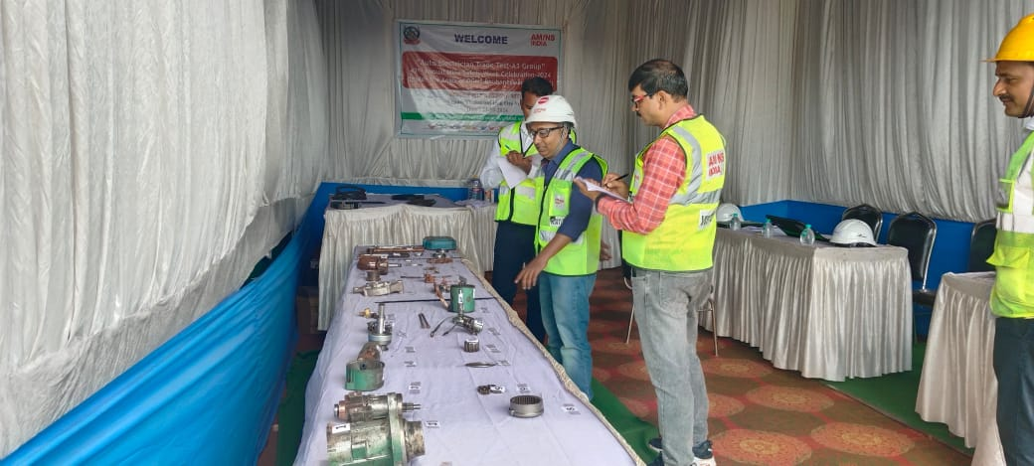
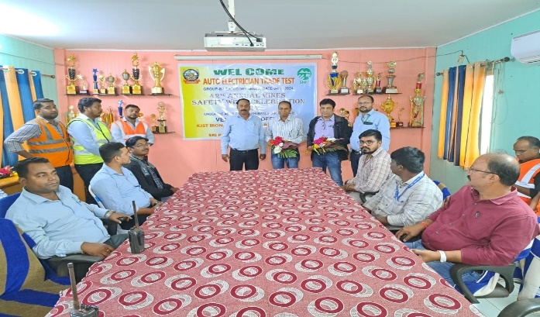
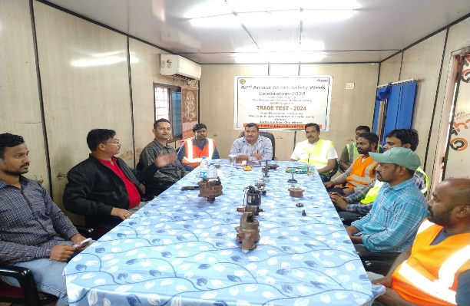
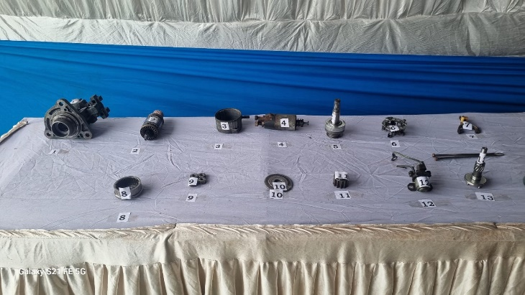
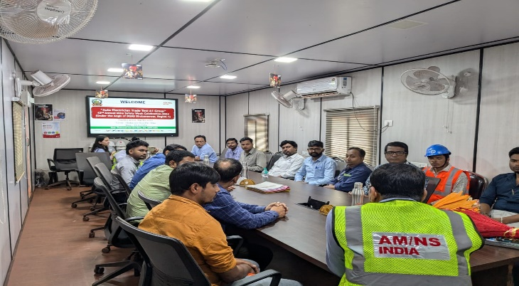
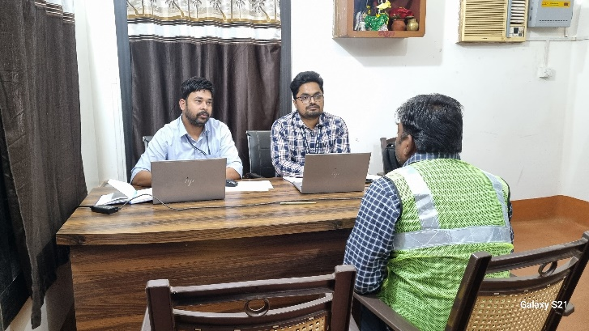
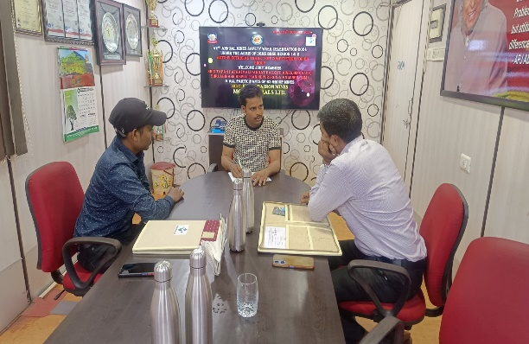
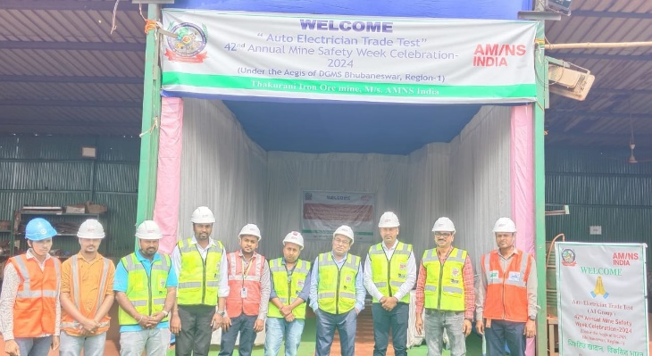
Trade Test
Trade:- Auto-Electrician

Slide 10
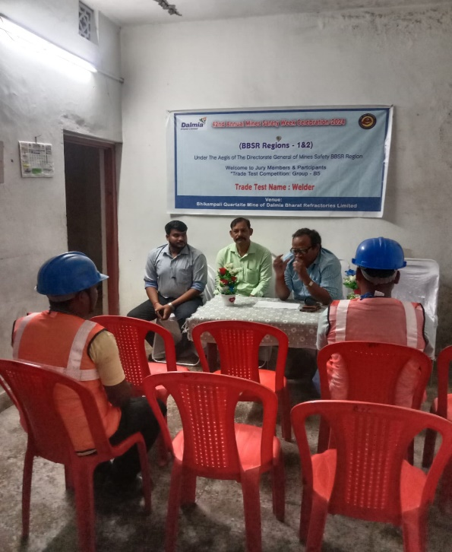
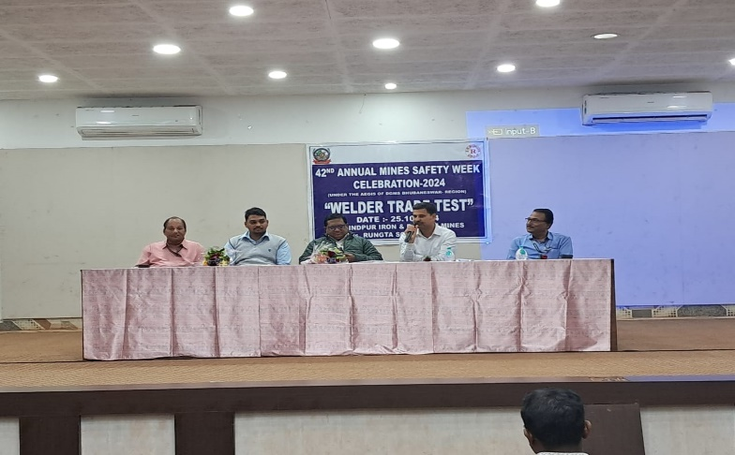
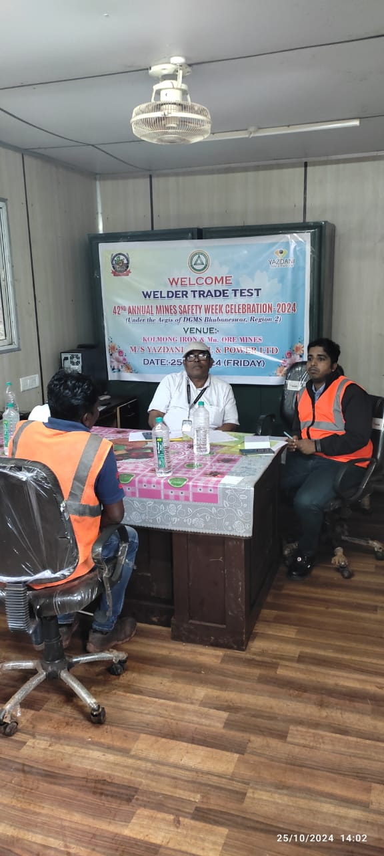
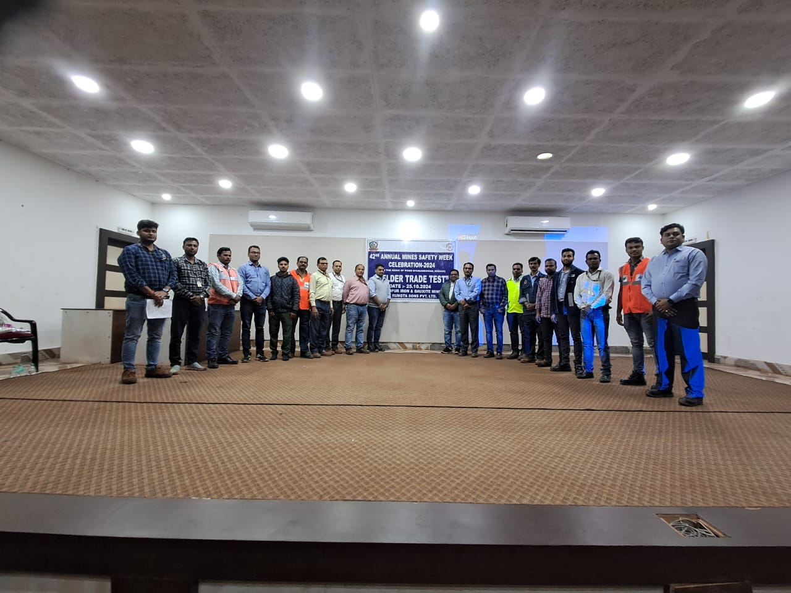



Trade Test
Trade:- Welder

Slide 11






Trade Test
Trade:- Blaster

Slide 12






Trade Test
Trade:- Mineral Processing

Slide 13

Trade Test
Trade:- Pump Operator

Slide 14
Summary Of Defensive Driving
& Trade Test
Defensive Driving Participants | Region-1 | Region-2 | Total
EZMA- Barbil | 115 |  | 227
South Kaliapani | 38
Koira ITI |  | 74
Trade Test | Region-1 | Region-2 | Total
No of Trade Tests Conducted: | 22 | 13 | -
No of Trade Tests Locations: | 41 | 37 | 78
No of participants attended: | 650 | 505 | 1155
No of Jury members attended: | 111 | 94 | 205
Defensive Driving:
Region-1(EZMA) = 115
Region-1 (South Kaliapani) =
Region-2 (Koira ITI) = 74
Trade Test:
No of Trades= 21
No of Locations= 78
No of Participants=
No of Jury Members Attended= 205

Slide 15
Summary of Participation & Advertisement Fees
Mine’s Participation Fees | Region-1 | Region-2 | Total
No of mines paid | 62 | 43 | 105
No of mines yet to pay | 07 | 04 | 11
Total | 69 | 47 | 116
Contractor Participation Fees | Region-1 | Region-2 | Total
Mines wise contractors paid | 30 | 16 | 46
Advertisement Fees | Region-1 | Region-2 | Total
No of Mines Paid | 10 | 07 | 17

Slide 16
Summary of Participation & Advertisement Fees
Figures in Lacs
Participation Fees | Region-1 | Region-2 | Total
Mines paid | 27.62 | 19.80 | 47.42
Contractors paid | 10.56 | 5.11 | 15.67
Advertisement | 1.15 | 0.60 | 1.75
Total | 39.33 | 25.51 | 64.84

Slide 17
Best Accident free, PSC, Woman, Transgender Nominations & Souvenir Articles
Nominations
Articles
Mines Submitted | Nos
Region-1 | 44
Region-2 | 36
Total | 80
Mines Submitted | Nos | English | Hindi | Odia
Region-1 | 25 | 25 | 00 | 00
Region-2 | 06 | 05 | 00 | 01
Total | 31 | 30 | 00 | 01
Name of Mines | No of Articles
OMC Ltd | 14
Tata Steel | 07
AMNS | 03
JSW | 02
JSPL | 01
Rungta & Sons | 02
Utkal Polyclinic | 01
Debabrata Behera | 01

Slide 18
Nomination of First-Aid & Quiz Competition
First-Aid
Quiz
No of Mines Submitted | Nos
Region-1 | 36
Region-2 | 22
Total | 58
No of Mines Submitted | Nos
Region-1 | 38
Region-2 | 23
Total | 61

Slide 19
Mode of Inspection marksheet/ result communications
Mail-ID

Slide 20
Thank You
&
All the best

